Slide 1

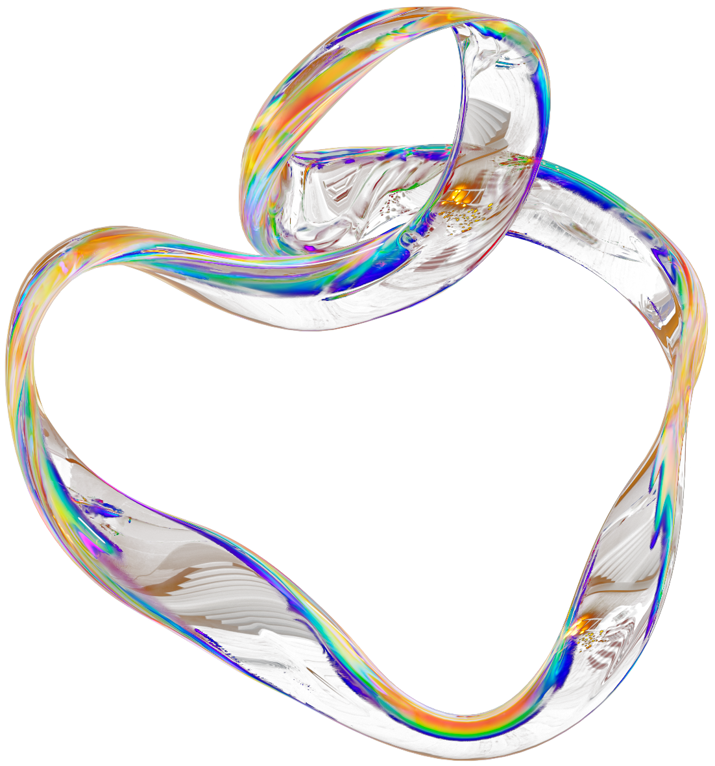
AI-Powered Slide Generation and Automation using
n8n

Slide 2
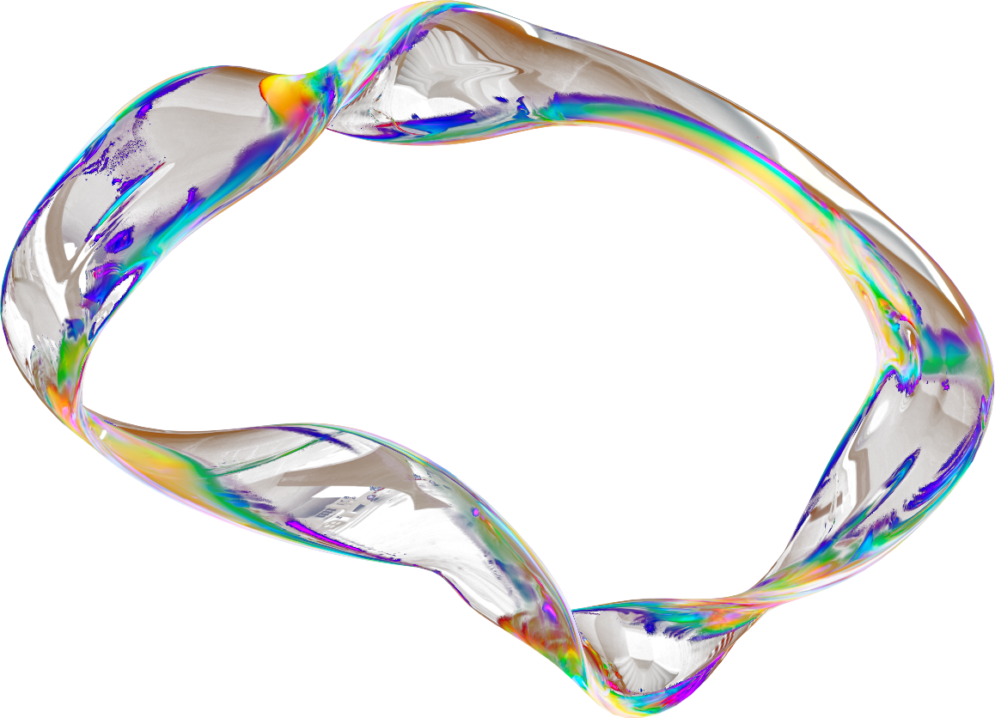


What is this project about?
Automated system to create Google slides using n8n workflow automation.
Uses ChatGPT models to generate slide content dynamically.
Automatically creates and shares Google Slides through Drive.

Slide 3
Why I built this project
Slide creation is repetitive and time-consuming.
Wanted to simplify content generation using AI automation.
Learn n8n workflow orchestration with API integrations.
Explore ChatGPT’s structured text generation in real projects.
Make slide editing faster by generating drafts that can be improved manually.
.

Slide 4
Tech Stack and Tools
n8n: Workflow automation platform
OpenAI GPT-4o: Generates slide content
Google Slides API: Creates presentation slides
Google Drive API: Shares slides automatically
Code Node (Guardrails) – Validates input and parses JSON safely.

Slide 5
How the Automation Works
User sends message in chat input (topic for slides).
Chat trigger captures the text.
GPT-4o-mini generates a title and structured JSON for slides.
Code node parses and validates the JSON.
Google Slides node creates a new presentation.
HTTP Request node adds slide content via Slides API.
Drive node shares the file (writer access).

Slide 6
AI Input & Output Safety
Weaknesses
Guardrails implemented in AI and Code nodes.
Blocks invalid or unsafe content.
Limits topic length and slide count.
Uses JSON parsing checks to avoid broken slide generation.
Ensures every slide has title, subtitle, and at least 5 bullet points.

Slide 7
Sample Interaction
User Input:
“Make me a presentation on the java collection framework.”
Generated Output:
Presentation created automatically in Drive.
Contains structured titles, subtitles, and bullet points.
Shared link sent for manual editing and improvement.

Slide 8
Outcomes
Reduced time to create slides by 90%.
Produced accurate, editable presentations with minimal manual effort.
Learned advanced n8n workflow design and API orchestration.
Successfully integrated ChatGPT content generation with Google APIs.
Enhanced reliability through guardrails and error handling

Slide 9
Next Steps
Add themes and custom templates automatically.
Integrate images and graphics using AI.
Support multi-language slide generation.
Deploy the workflow publicly for reuse.
Connect to Telegram bot for real-time two-way interaction.

Slide 10

The End

